Slide 1


Exploring Transfer Learning for End-to-End Spoken Language Understanding
Subendhu Rongali*, Beiye Liu, Liwei Cai, Konstantine Arkoudas,
Chengwei Su, and Wael Hamza
Amazon Alexa AI
*University of Massachusetts Amherst
(work done during summer internship)
Notes:
Hi. My name is Subendhu. I'm a fourth year PhD student at UMass Amherst. I'm here to present our work titled "Exploring Transfer Learning for End-to-End Spoken Language Understanding". I did this work as part of my summer internship at Amazon Alexa with my co-authors Ben, Liwei, Konstantine, Chengwei, and Wael.

Slide 2
Outline
Spoken Language Understanding (SLU)
Motivation for End-to-End SLU
Our Problem Statement
Background
The AT-AT Model
Evaluation
Conclusion
Notes:
Before we begin, I want to provide a quick outline of this talk. I'm going to start with a description of the Spoken Language Understanding task and the motivation for end-to-end SLU. That will then lead to our problem statement. We will then look at some background work, followed by the description of our model, which we call the AT-AT. model We will then wrap up with evaluation of AT-AT and conclusion.

Slide 3
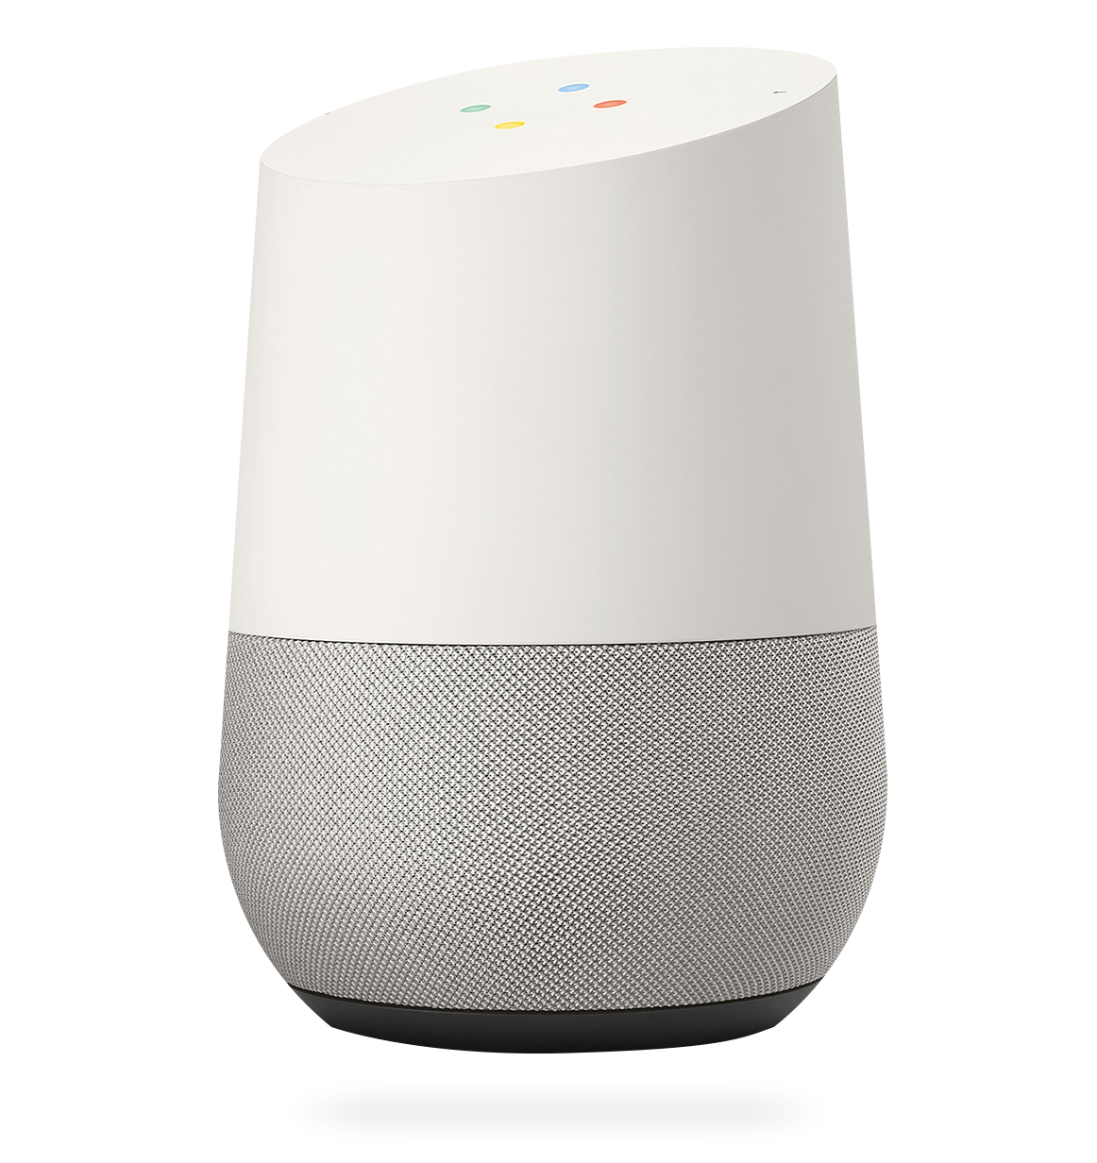
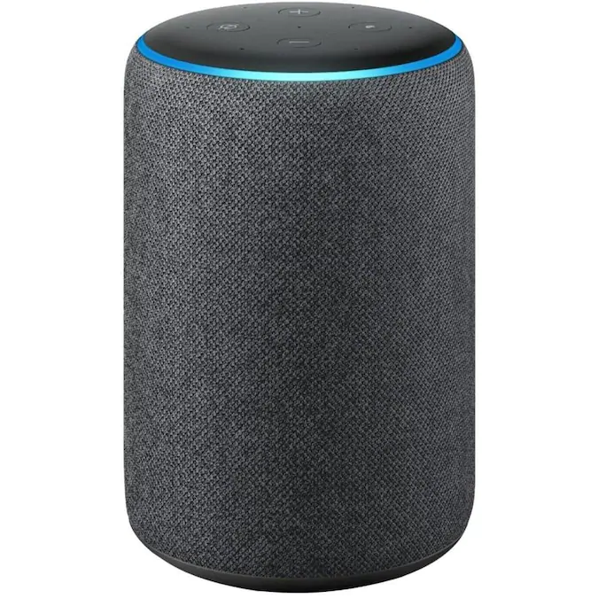

Spoken Language Understanding (SLU)
Important component in voice assistants
Convert audio into an actionable hypothesis with intent and slots
Notes:
First, what is Spoken Language Understanding? As the name implies, it is - trying to understand spoken language. It is an important component in voice assistants such as Alexa, Siri, and Google assistant. The goal of SLU is to convert audio, which is typically a request from a user, into an actionable hypothesis with intents and slots.

Slide 4


Spoken Language Understanding (SLU)
Intent: PlayMusic
Slots: SongName don’t stop believing
(play don’t stop believing)
PlayMusic( play SongName( don’t stop believing )SongName )PlayMusic
Notes:
For example, say a user utters the sentence “play don’t stop believing”. The goal of SLU is to convert this audio into something that looks like this. We extract the user’s intent, which is play music and the what to play, which is a song name slot corresponding to the words don’t stop believing. This hypothesis can also be written as a sequence, which looks like this, where we wrap the user-uttered words with intent and slot tags.

Slide 5




Motivation for End-to-End SLU
ASR
NLU
Text Transcription
NLU Hypothesis
E2E
NLU Hypothesis
Smaller and faster engine!
No cascading errors!
Possibly better optimization!
Notes:
Traditionally, SLU has been performed as a two-step process. The user audio is first sent through an automatic speech recognition or ASR system to generate the text transcription. The transcription is then sent through a Natural Language Understanding system to generate the hypothesis. The goal of E2E SLU is to do this whole thing in one step. Benefits of doing this include a smaller and faster engine (which could allow voice assistants to work offline), elimination of cascading errors, and possibly better optimization (since it is an end to end system).

Slide 6
Limitations of End-to-End SLU Models
They require lots of end-to-end training data
There is a huge amount of ASR (speech-text) and NLU (text-NLU) training data that is not used
Can’t support feature expansion, a scenario where a voice assistant’s capabilities are increased to handle a new domain using just text data
Notes:
End-to-End models however have lots of limitations that prevent them from being used in practice. They require lots of end-to-end data to train because these systems tend to typically be large. Also, there is a huge amount of ASR and NLU data, from the traditional 2-step model training that is not used, since the data need to be aligned. These models also can't support something called feature expansion. It is a scenario where a voice assistant's capabilities are increased to handle a new domain and it is typically done with just some text examples and no audio.

Slide 7
Problem Statement
Improve SLU performance: Design an end-to-end SLU model that can transfer knowledge from other available data sources (ASR, NLU). This model can then be used to improve performance in both limited and full data scenarios.
Support feature expansion: Design the end-to-end model to train on a new domain with just text-based data and no audio data (zeroshot).
Notes:
This brings us to our problem statement, which is 2-fold. First, we want to improve performance of E2E SLU models. We want to design a model that can transfer knowledge from other available data such as ASR and NLU training data so that it can do well in both low resource and high resource scenarios. Next, we want to support feature expansion. To do this, we need to design an end-to-end model that can train on a new domain with just text data and zero audio data, which is, in a zeroshot fashion.

Slide 8
Background
Audio Processing
Neural ASR
End-to-End SLU Models
Notes:
Let us now go through some background literature that is relevant to our work. We will look at background on three topics: audio processing, neural automatic speech recognition, and e2e SLU models.

Slide 9
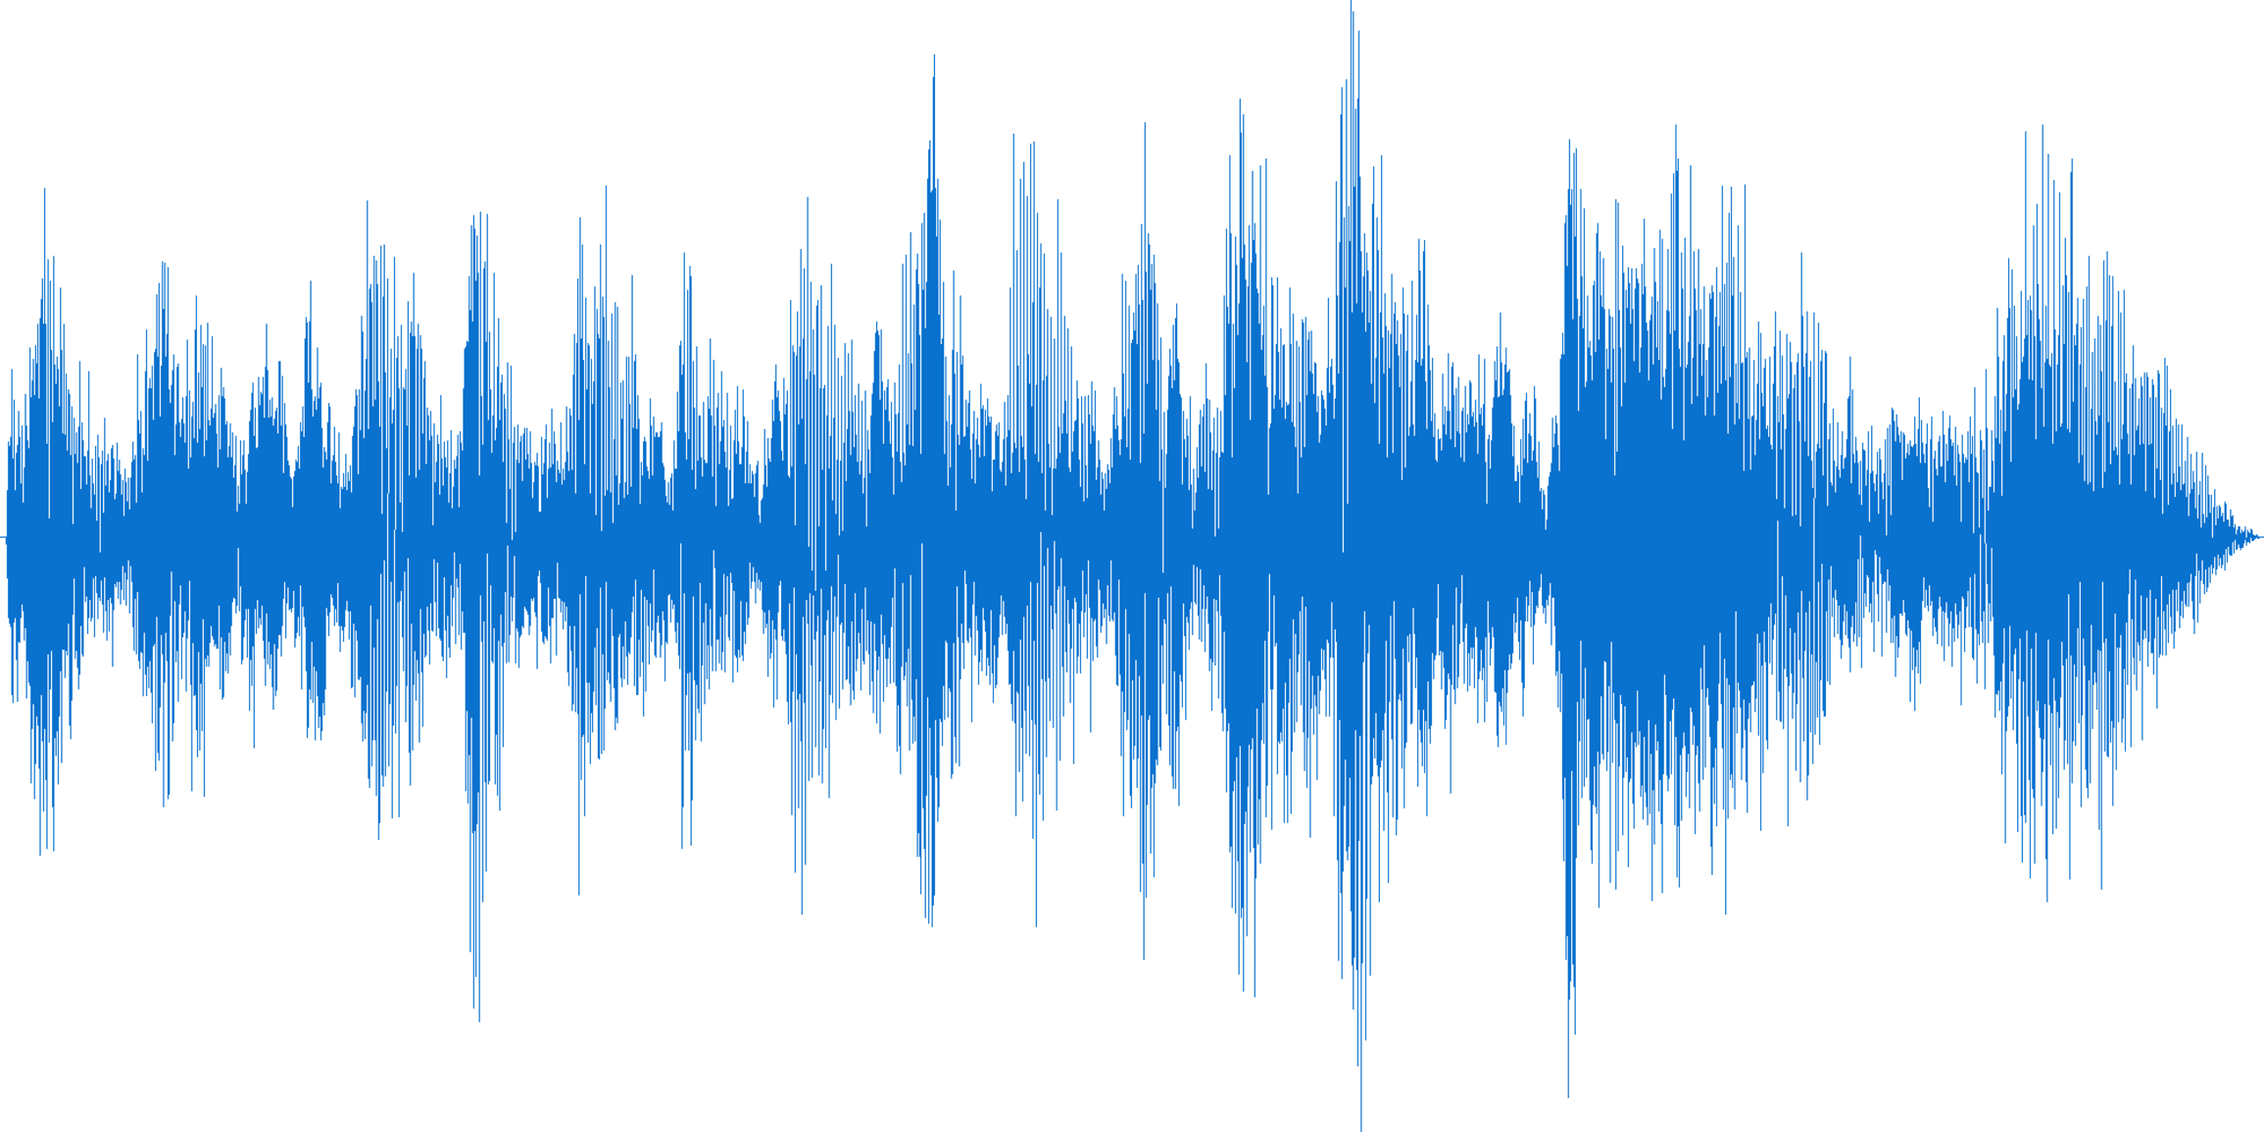
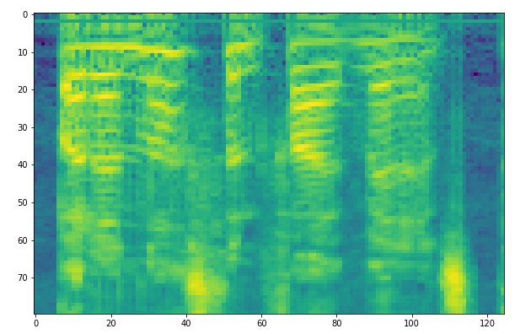
Background: Audio Processing
Log Filter-bank spectrograms
Normalized with a mean and variance to make input Gaussian
Audio waveform
Spectrogram
Notes:
Audio processing is an important part of all SLU systems because we need to process the user audio into a format that extract relevant data to send to our model. There are many ways to do this, but we use log filter-bank spectrograms for this work. Furthermore, we make this Gaussian by normalizing with mean and variance. This process looks like this. Notice how the spectrogram looks like an image with the x-axis corresponding to time.

Slide 10
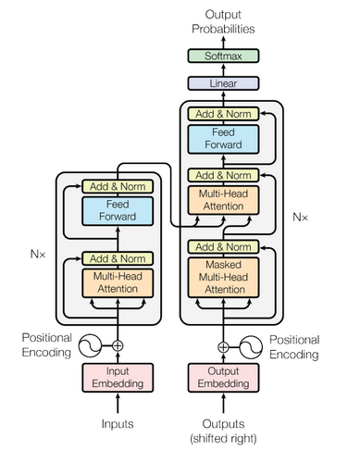
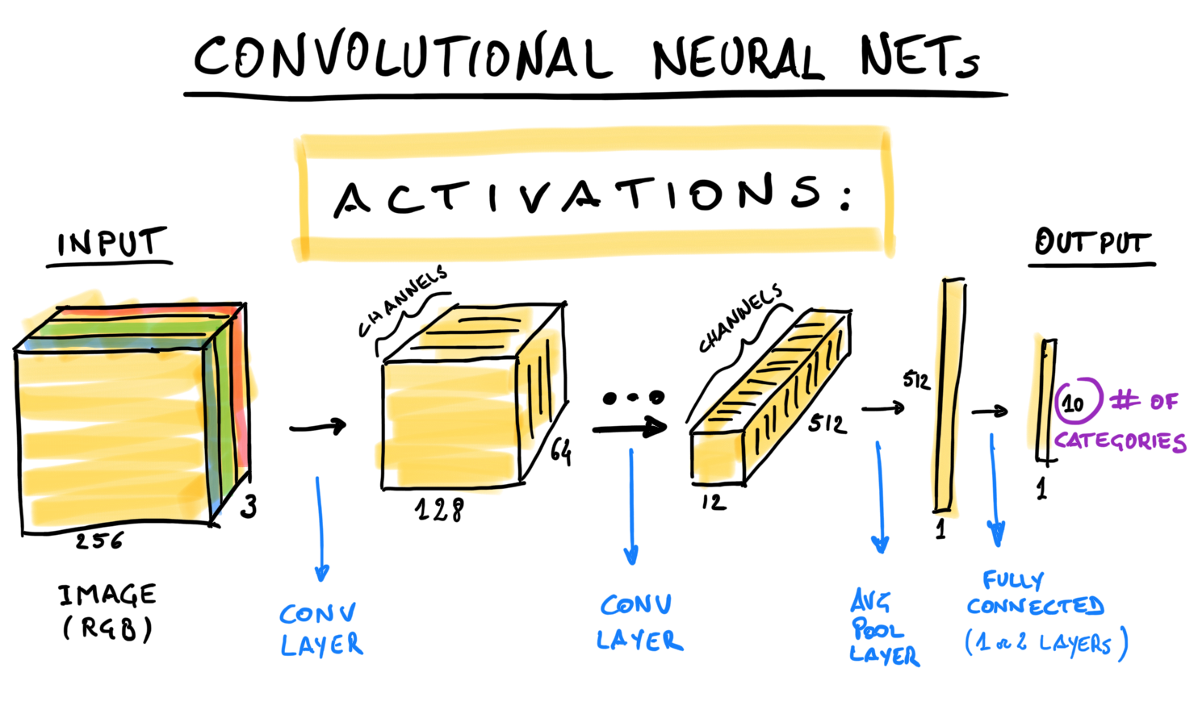
Background: Neural ASR
Speech-Text Sequence to Sequence models based on transformers [Karita et al 2019, Mohamed et al 2020]
Models consists of 2D conv layers, and a transformer encoder-decoder framework
1. A Comparative Study on Transformer vs RNN in Speech Applications. Karita et al 2019. arXiv:1909.06317v2 [cs.CL]
2. Transformers with convolutional context for ASR. Mohamed et al. 2020. arXiv:1904.11660v2 [cs.CL]
Notes:
Now some background on neural ASR. ASR was traditionally performed using hidden Markov models, followed by language model re-ranking. More recently however, transformer-based sequence to sequence models have become very popular. These models consists of some 2D conv layers to process the audio spectrogram, followed by a transformer encoder-decoder framework.

Slide 11
Background: End-to-End SLU Models
Repurpose neural ASR models [Hagani et al 2018]
Audio LFB
signal
PlayMusic( play SongName(
don’t stop believing ) )
1. From audio to semantics: Approaches to end-to-end spoken language understanding. Hagani et al. IEEE SLT Workshop 2018
Notes:
Based on the architecture of these ASR models, there has been some prior work on E2E systems. Here, researchers repurpose the ASR model to do SLU. They first take a seq-to-seq model that looks something like this, you have the audio encoder with the convolutional layers and a target sequence decoder. The input to this model is again going to be audio. The target sequence however is now going to be the SLU hypothesis as opposed to just the transcript in the case of ASR.

Slide 12

The Audio-Text All-Task (AT-AT) Model
Designed to perform knowledge transfer by training on many different tasks with seq-to-seq style data [Raffel et al. 2019]
The tasks can contain either audio or text input sequences but must contain text output sequences
1. Exploring the Limits of Transfer Learning with a Unified Text-to-Text Transformer. Raffel et al. 2019. arXiv:1910.10683v2 [cs.LG]
Notes:
Now, let's look at our work. We call our model the Audio-text all-task model or AT-AT. It is designed to transfer knowledge by training on many different seq-to-seq style tasks. This idea is similar to the T5 work by Raffel et al in 2019, where the author built a text transformer model that is jointly trained on many text tasks such as summarization, translation, and QA. We extend this to the audio setting. The tasks for AT-AT can contain either audio or text input sequences but must contain text output sequences. Quick side note if you were wondering, AT-AT should remind of this thing from Star Wars.

Slide 13




This is what it looks like
SLU
PlayMusic( okay Artist( rihanna )Artist )PlayMusic
AT-AT
ASR
Audio
Encoder
Joint
Target
Decoder
it was a glorious morning to wake up to
an old-fashioned bar was close by
MLM
Text Encoder
PlayMusic( play Song( don’t stop believing )Song )PlayMusic
NLU
play don’t stop believing
Notes:
Moving on, this is what our AT-AT looks like. In this figure, we can see it being trained with four tasks: SLU, ASR, MLM, and NLU, each color coded and labelled. In green you have SLU where the audio is converted to a hypothesis. In red, you have AS, where the audio is converted to a transcript. The blue task is a masked language model task where we mask out audio corresponding to certain words but ask the model to predict the whole transcript. In essence, it is a more difficult ASR task which forces AT-AT to learn a language model. Finally, in black, we have the NLU where the input is a text transcript, and the target is the hypothesis. Note that the audio and text inputs go through separate encoders but share a joint target decoder. The model is trained to differentiate between various tasks by taking the task-label as input and using it as the first token or the BOS token while decoding the target sequence.

Slide 14
AT-AT: Model Components
Audio Encoder
CNN Embedder
Transformer Encoder
Joint Target Decoder
Transformer Decoder
Embedder
BERT Encoder
Embedder/Generator
Text Encoder
Notes:
Here's a more detailed look at AT-AT with its model components. The audio encoder is similar to the audio encoder from ASR systems. It contains the convolutional layers and a transformer encoder. In addition, AT-AT has a text encoder to process text inputs. We use a pre-trained BERT encoder, which is widely used in NLP literature, as our text encoder. We then have a joint target decoder similar to the decoder in other sequence-to-sequence models. The uniqueness of AT-AT comes from the fact that this one decoder decodes target sequences from the hidden states of both the audio and text encoders.

Slide 15
How can we do zeroshot with this?
In the zeroshot setting, we have text NLU data for a new domain but no corresponding audio.
Since AT-AT is trained on both audio and text input data from multiple tasks, we hypothesize that it learns a shared audio-text space.
It can then be trained with text data from a new domain and we expect to see it generalize to audio from that domain.
Notes:
Now, it is easy to see why there would be performance improvements. They would come from the knowledge transfer from various tasks. But how can we do zeroshot and feature expansion with this? If you recall, in the zeroshot setting, we have text NLU data for a new domain but no corresponding audio. Since AT-AT is trained on both audio and text input data, we hypothesize that it learns a shared audio-text space. It can then be trained with text data from a new domain and we expect to see it generalize to audio from that domain.

Slide 16
The shared audio-text space
The shared audio-text space is usually learned by explicitly forcing alignment such as an L2 penalty [Denisov et al. 2020]. This requires parallel audio-text data.
Furthermore, it also requires the speech signals to be chunked and aligned with words or word-pieces in the text.
Our approach requires neither. By constraining AT-AT to use a shared decoder, we inherently force the model to learn a shared audio-text latent space.
1. Pretrained semantic speech embeddings for end-to-end spoken language understanding via cross-modal teacher-student learning. Denisov et al. 2020. arXiv:2007.01836 [cs.CL]
Notes:
A little more discussion on this shared audio-text space, this king of shared audio-text space is usually learned by explicitly forcing alignment using a penalty like L2 (there's reference on this). This requires that there be parallel audio-text data. Furthermore, the alignment is done on a word-level, so the audio needs to be chunked to get word-level audio alignment. Our approach eliminates all these requirements. By simply constraining AT-AT to use a shared decoder, we forces to model to inherently learn this shared audio-text latent space.

Slide 17
AT-AT: Three phases
Pretraining
Finetuning
Zero-shot learning
Notes:
Moving on, let's now look at how AT-AT is trained and used in inference. It has 3 phases: pretraining, finetuning, and zero-shot learning.

Slide 18
AT-AT: Pretraining phase
The model is trained using all available data from multiple tasks such as ASR, SLU etc. The goal is to learn as much knowledge as possible.
The task label, which denoted which task is being performed, is passed as the BOS token while decoding.
Source | Task | Target
Audio1.wav | ASR | play the latest hit songs
Audio2.wav | ASR | let’s listen to early nineties hip hop songs
Audio3.wav | SLU | PlayStation( play StationName(ninety-three f m )StationName)PlayStation
Audio4.wav | ASR | skip this song
Audio5.wav | SLU | PlayMusic( play ArtistName( the weeknd )ArtistName )PlayMusic
… |  | ….
Notes:
The pretraining phase is where the model is trained using all available data from all tasks. The goal is to learn as much general knowledge as possible before adapting to a specific task. As mentioned earlier, the task label is passed as the BOS token while decoding. The data in this phase looks like this. In this chart we have data from two tasks: ASR and SLU. The ASR examples (rows 1, 2, and 4) all have audio inputs and transcripts as target. The SLU examples (rows 3 and 5) have hypotheses as targets.

Slide 19
AT-AT: Finetuning phase
In this phase, we simply continue training AT-AT on a specific downstream task that we want to evaluate on.
This is done with gradual unfreezing with different learning rate multipliers to prevent any catastrophic forgetting.
Notes:
In the finetuning phase, we simply continue training to adapt AT-AT to a specific downstream evaluation task. We do this training using gradual unfreezing, with different learning rate multipliers, to prevent any catastrophic forgetting.

Slide 20
AT-AT: Zeroshot phase
The zeroshot approach is inherently supported by AT-AT due to its design. If the model was trained with at least one audio and one text task in the pretraining phase, it already learns a shared audio-text representation.
So, this phase is simply finetuning with text data from a new domain.
Notes:
The zeroshot phase comes up when we want to do zeroshot learning for feature expansion. So, we have text training data for a new domain but no audio. This setting is inherently supported by AT-AT due to its design. We just require that the model, in the pre-training phase, is trained on at least one audio-text and one text-text task to learn the shared audio-text space. Once this is done, this phase boils down to just finetuning with text data from the new domain.

Slide 21
Zeroshot with Text-to-Speech systems
Another way to perform the zeroshot end-to-end SLU is to convert the text input data into audio data using a Text-to-Speech (TTS) system.
We can then use this synthetically generated audio data to train an E2E model.
AT-AT works without access to any TTS system.
It can also work along with it because we can simply add the synthetic audio data to the finetuning phase.
Notes:
Before we move on to evaluation, a quick note on another way to do zeroshot end-to-end SLU from literature. The issue is that we have text data but no audio. We can solve this by using a Text-to-Speech or TTS system to convert the text into synthetic audio. Once this is done, we can train an E2E model with the resultant synthetic dataset. The catch here though is the access to a TTS system. Our model works even without access to a TTS system. Moreover, it can also work along with a TTS system to further get better. We simply add the synthetic audio data to the finetuning phase.

Slide 22
Evaluation
AT-AT in Low Resource Settings
Building better E2E Models with AT-AT
AT-AT on Public Datasets
Zeroshot E2E with AT-AT
Notes:
Let's now discuss the evaluation of AT-AT. We evaluate AT-AT in four scenarios. First, we look at AT-AT in low-resource settings, where we have limited audio data. We then look at building better E2E models with AT-AT when there are no resource restrictions. We then evaluate AT-AT on some popular public datasets. Finally, we wrap with evaluating AT-AT in the zeroshot E2E setting.

Slide 23



AT-AT in Low Resource Settings
We sample utterances from the user traffic of Alexa. This is done in compliance with user privacy commitments.
Full Data 100% Speech-SLU 3.3M Train, 98k Valid
ASR Data 90% Speech-Transcription 3M Train, 90k Valid
Music Data Speech/Transcription/SLU 3.3M Train, 98k Valid, 125k Test
Limited Data 10% Speech-SLU 330k Train, 9k Valid
Notes:
For the low resource setting, we perform experiments on an internal dataset. We sample utterances from Alexa's user traffic in compliance with our user privacy commitments. I will now describe the construction of this dataset pictorially.
We start with a huge dataset of user utterances sampled from the music domain in Alexa. This dataset contains about 3 million utterances, each containing the audio, transcript, and the hypothesis. From this we construct a full E2E dataset containing the audio and SLU hypotheses from all examples. In addition, we construct a limited low resource dataset by sampling 10% of the dataset and extracting the audio and hypotheses. For the remaining 90% of the data, we extract the audio and the transcript to create an ASR dataset. Our goal in this experiment is to train a model with the limited end-to-end data and the additional ASR data and try to match the performance of a model trained on the full data.

Slide 24
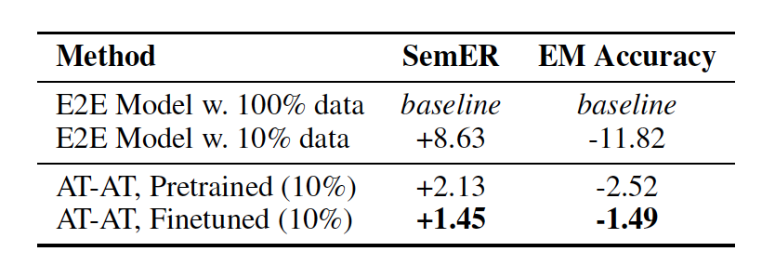
Results
Notes:
Here are the results. For exact details of the model sizes and hyper-parameters, please refer to our paper. We report relative numbers due to internal restrictions on user data. We use an end-to-end model trained on the full dataset as the baseline. As expected, when the same model is trained on just 10% of the data. We see a significant drop in performance. The metrics we use here are SemER, or semantic error rate is an internal metric used for assessing model built for Alexa. It is similar to word error rate, which measures the number of insertions, substitutions, and deletions, but adapted to a hypothesis setting. Not that lower the error rate, the better. EM Accuracy or exact match accuracy is simply the accuracy for the entire predicted hypothesis exactly matching the true hypothesis. The higher the accuracy, the better. So, the end-to-end model trained on 10% data loses around 9 points in SemER and 12 points in accuracy. AT-AT when trained with addition ASR data, recuperates most of this performance. The SemER is only 2 points over the baseline. When further finetuned, it get's even better to almost within a point of the full model's performance.

Slide 25
Building better E2E Models with AT-AT
Here, we want to use the full music dataset from the previous experiment and add external data from other sources to see if we can improve performance.
We pretrain AT-AT with 3 tasks: SLU, ASR, MLM.
We use ASR data from LibriSpeech [Pananyatov et al. 2015]. It consists of ~ 1000 hours of data of multiple speakers reading books from the LibriVox project.
We construct MLM data also from LibriSpeech by using a third-party aligner tool called Gentle
LibriSpeech: an ASR corpus based on public domain audio book. Panayotov et al ICASSP 2015
Gentle: Robust yet lenient forced-aligner built on Kaldi. https://github.com/lowerquality/gentle
Notes:
The next scenario we evaluate on is without any restrictions. We want to use the full music dataset from the previous experiment and pretrain with additional external data from other sources to see if we can improve the baseline model's performance. We pretrain AT-AT with 3 tasks: SLU, ASR, and MLM. For ASR, we use data from the LibriSpeech corpus, a publicly available ASR corpus of ~1000 hours of data constructed from speakers reading books. We construct the MLM data from the same corpus by aligning the audio and masking segments.

Slide 26
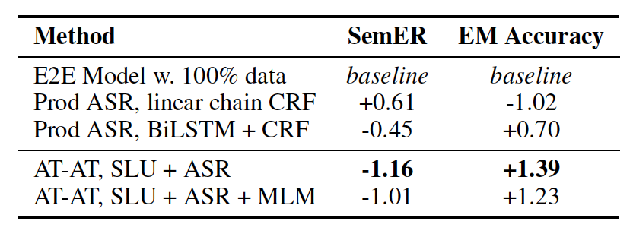
Results
Notes:
We see that AT-AT shows noticeable improvements over the end-to-end baseline, and also a couple of 2-stage pipeline models. We again report relative numbers with the basic end-to-end model as the baseline. A simple two stage pipeline with a production level ASR system and a linear chain CRF NLU model is slightly worse than this baseline and a more complex two stage pipeline with a deep BiLSTM and CRF model beats the baseline by half a point in SemER. AT-AT, when pretrained with addition ASR and MLM data beats all these models. It improves upon the SemER and accuracy by a full point when trained with both two tasks and three tasks, showing that there is significant knowledge transfer taking place that contributes to SLU performance improvements.

Slide 27
AT-AT on public datasets
We evaluate AT-AT on two public datasets
FluentSpeech [Lugosch et al 2019]
SNIPS Audio [Saade et al 2019]
1. Speech Model Pre-training for End-to-End Spoken Language Understanding. Lugosch et al 2019. arXiv:1904.03670v2 [eess.AS]
2. Spoken Language Understanding on the Edge. Saade et al 2019. arXiv:1810.12735 [cs.CL]
Notes:
Next, we evaluate AT-AT on two public datasets, FluentSpeech and SNIPS audio.

Slide 28
FluentSpeech
Speech-NLU dataset where NLU is a 3-tuple of (action, object, location)
We convert this into a sequence using fixed processing rules
Example:
Audio : Turn on the kitchen lights
Tuple : activate, lights, kitchen
Target : Activate( Turn on the Location( kitchen )Location Object( lights )Object )Activate
23k train, 3k valid, 4k test
SOTA models solved this as a 3-way classification task, we solve it as a generation task. Our model has a more difficult task!
Notes:
Fluent Speech is a speech commant dataset where the NLU hypothesis is a 3-tuple of action, object, and location. We convert this into a sequence using fixed rules. For example, take the command turn on the kitchen lights. The original hypothesis, which is a 3 tuple, is activate, lights, and kitchen corresponding to the action, object, and location. We convert this into a sequence with appropriate tags so that it can be solved using our sequence-to-sequence model framework. SOTA models on this dataset solve this problem as a 3-way classification task which we solve it as a generation task, making out model's job more difficult.

Slide 29
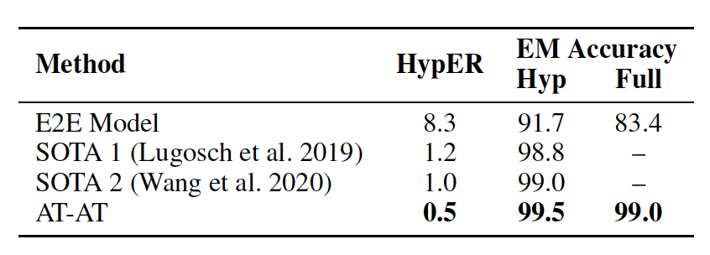
Results
Notes:
Here are the results on FluentSpeech. SOTA models are both deep neural networks. The first one is an RNN based model and the second one is a transformer-based model and they both achieve a hypothesis error rate of close to 1, corresponding to 99% exact match accuracy. A simple end to end model doesn't come close to this performance since the dataset is too small to train a big end to end model. However, AT-AT beats the SOTA models and achieves an error rate of just 0.5, corresponding to a 50% error reduction over the best previous model.

Slide 30
SNIPS Audio
We use the smart-lights dataset
Contains two sets: close field and far field
1660 examples, numbers reported on 5-fold cross validation
SOTA models
SNIPS pipeline: acoustic model, LM, NLU slot-filler
Google DialogFlow Service
Notes:
Our next public dataset is SNIPS Audio. Within this, we use the smart-lights dataset which contains a close field and far field split depending on the mic placement. These datasets are extremely small, containing only 1660 examples. The SOTA models we use for comparison are given here and you can refer to our paper for model details on them.

Slide 31
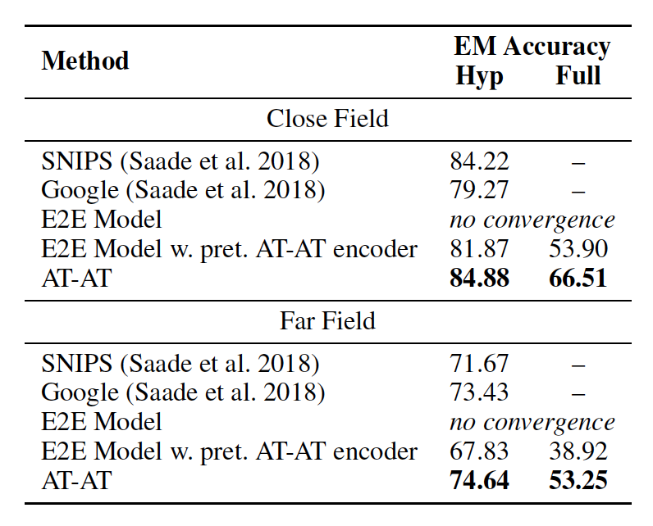
Results
Notes:
Here again we see that AT-AT does better than both the SOTA models and an end-to-end model on both splits. Note that a simple end to end model doesn't even converge since the dataset is so small, so we use a pretrained encoder for reference.

Slide 32
Zeroshot E2E with AT-AT
We test on internal Alexa data from the books domain, and on a public dataset called Facebook TOP [Gupta et al. 2018]
Synthetic data for experiments was generated from Amazon Polly.
Books data has real audio to test on, but TOP data doesn’t, so we collected audio for a fraction of the TOP test set and created a new dataset. This will be released for future research.
1. Semantic Parsing for Task Oriented Dialog using Hierarchical Representations. Gupta et al. EMNLP 2018
Notes:
Our last set of experiments measure the zeroshot capability of AT-AT. We test on an internal Alexa dataset from the book domain, and also on a public dataset called Facebook TOP, which contains more complex SLU hypotheses with nested intents and slots. Synthetic audio for these experiments was generated using the Amazon Polly TTS service. Quick note, the books data from Alexa has real audio data to test on but TOP is a text dataset. So, we collected audio for a fraction of the TOP test set and created our own zeroshot test set. We will release this for future research.

Slide 33
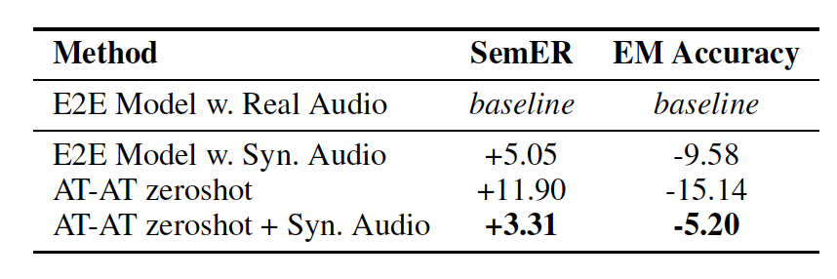
Results: Alexa Books
Notes:
Here are the results for the Alexa books dataset. We use an end-to-end model trained on real audio data as the baseline. When trained on synthetic audio in a zeroshot setting and evaluated on real data, the SemER drops by 5 points. The AT-AT model, without any synthetic data performs respectably here with a SemER within 11 points. With synthetic data added in during finetuning though, it beats a simple end to end model trained on synthetic data and obtains an error rate within 3 points of the baseline.

Slide 34
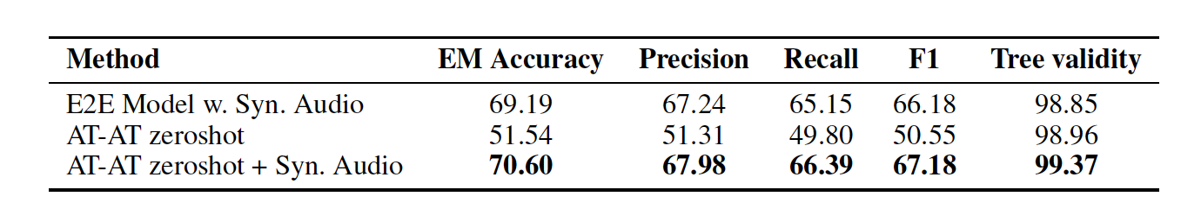
Results: Facebook TOP
Notes:
We see a similar trend with Facebook TOP. We don't have the real audio data baseline here because there is no audio training data. An end-to-end model with synthetic data obtains an accuracy of 69% while the AT-AT model gets close to 71% when finetuned with the synthetic data and 56% without any synthetic data.

Slide 35
Conclusion
We built AT-AT, a transfer learning-based audio-text shared space model that improves performance on various downstream tasks.
We report improvements on various internal Alexa datasets, as well as public datasets such as SNIPS and FluentSpeech.
We show how AT-AT can be used to perform zeroshot E2E SLU and report improved results on internal Alexa and Facebook TOP datasets.
We release the audio dataset collected for Facebook TOP for future research.
Notes:
To conclude, ....

Slide 36
Thank you!
For any questions, please reach out to me at srongali@cs.umass.edu

